Slide 1
Presentation 1
Requirements Engineering - intelliPhoto

Slide 2
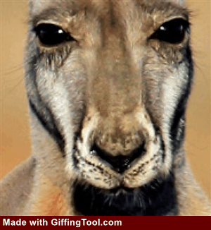
Set new color values in the image

Slide 3





Set new color values in the image
Pen Tool
Flood Fill
Undo/Redo Tool
Plain Tool
Forms Tool

Slide 4
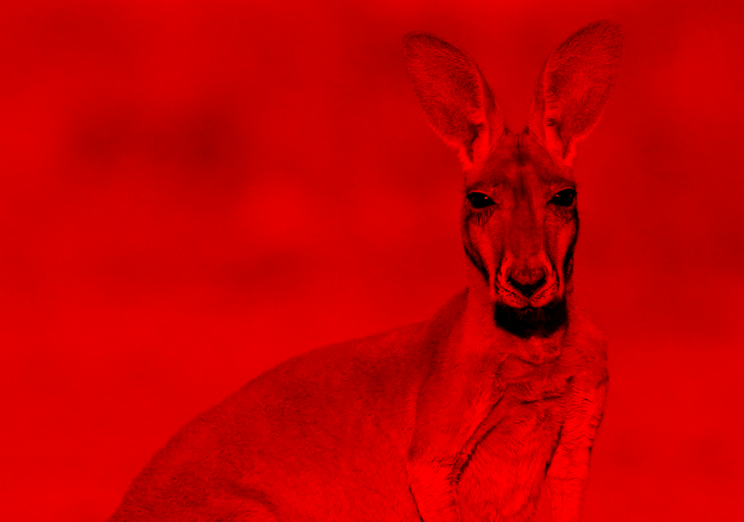
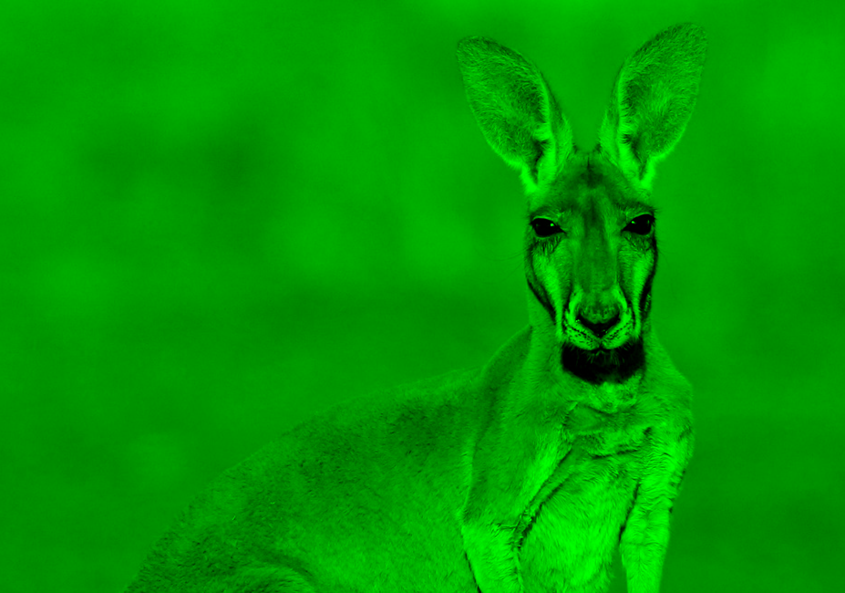
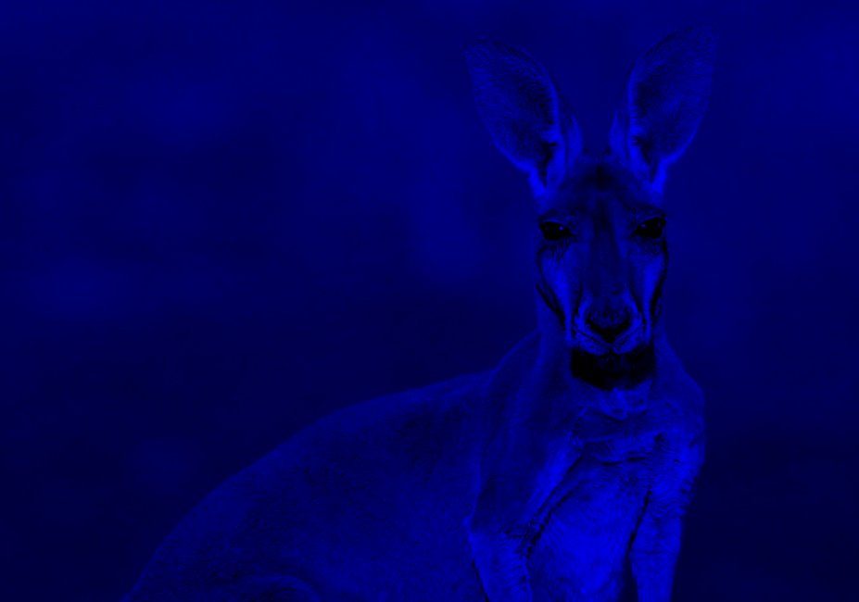
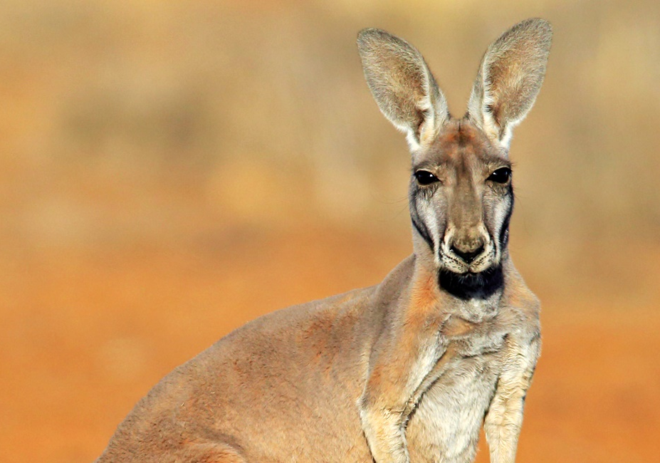
Representation of a pixel by means of a byte
Red
Green
Blue
+
+
makes

Slide 5



Representation of a pixel by means of a byte
> Variant 1
01010100
TTRRGGBB
R
T – Transparent Channel
R – Red Channel
G – Green Channel
B – Blue Channel
G
B
2^6 different colors with transparency steps

Slide 6
Representation of a pixel by means of a byte
> Variant 2
00 – Transparency/Gray
01 – Red
10 – Blue
11 - Green
01010100
CCVVVVVV
0100‘0000
0111‘1111
V – Value
C – Color Channel
Allows for 64 color values per color, so 192 colors + 63 grayscale colors in total (since transparency shouldn‘t allow for steps)

Slide 7
Representation of a pixel by means of a byte
> Variant 2

Slide 8
Representation of a pixel by means of a byte
> Variant 3
Color List
00000011
0
3
1
2
3
4
5
…

Slide 9
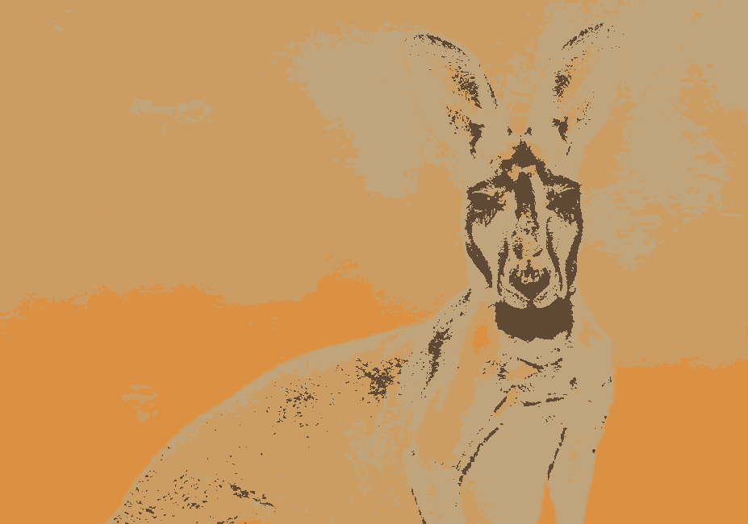
Representation of a pixel by means of a byte
> All Variants
Means very noticeable loss of color variation

